Slide 1
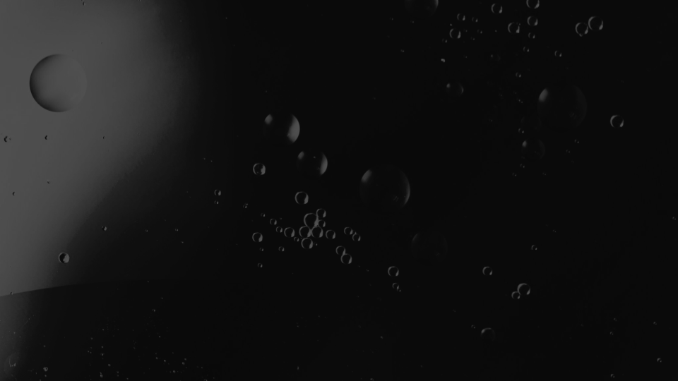

Galactic Gourmet
Loretto Abbey Team B: Food Storage and Preparation

Slide 2

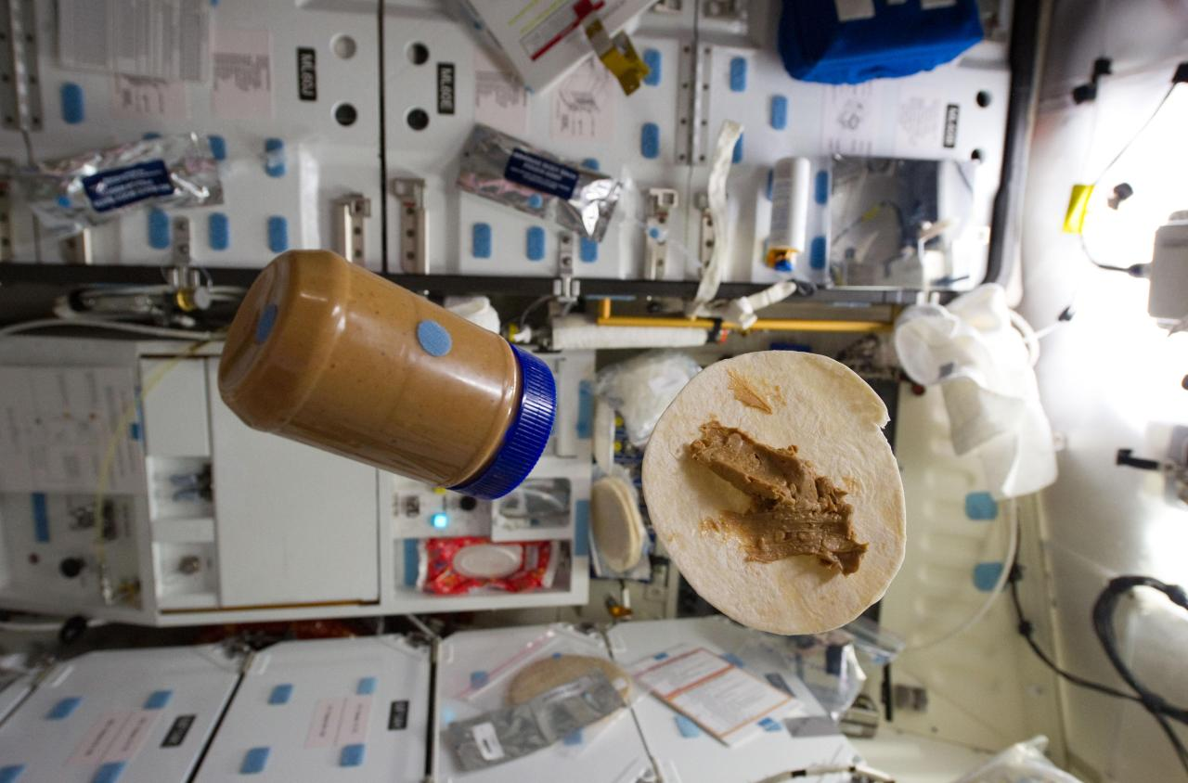

Slide 3
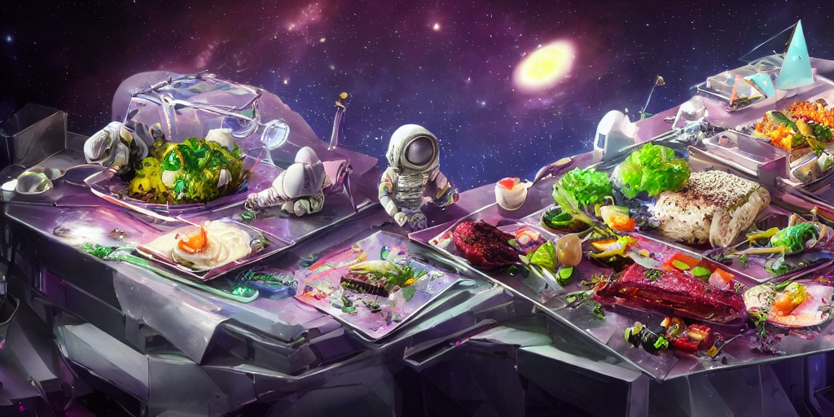
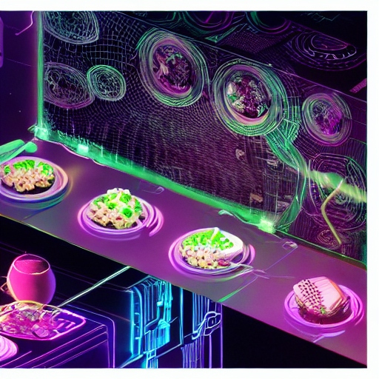
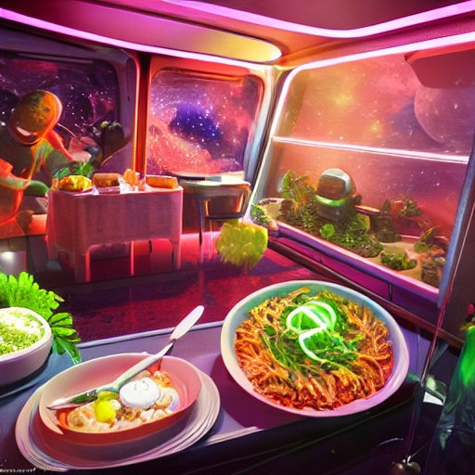

Slide 4
Functions
(1) Preserve and store perishable
and non-perishable food
(2) Prepares food
for astronauts’ consumption
(3) Treats and stores sufficient clean water

Slide 5
Objectives
Lightweight
Low Material Cost
Low Energy Consumption
Palatable Food Taste

Slide 6
Constraints
Microgravity
Power Limit: 5 kW
Dimensions: 3m x 3m x 6m
Mass: 2500 kg

Slide 7
Elimination Process:
Weighted Decision Matrix

Slide 8
Food Storage
 | Lightweight (Weight: 0.3) | Low material cost (Weight: 0.3) | Low power consumption (Weight: 0.3) | Palatable food taste (Weight: 0.1) | Weighted Total
Oil-free compressor fridge | 1 | 1 | 1 | 9 | 1.8
Airlock unit outside the spacecraft | 5 | 3 | 10 | 7 | 6.1
Freeze-drying | 9 | 10 | 7 | 6 | 11.2

Slide 9
Food Storage
 | Lightweight (Weight: 0.3) | Low material cost (Weight: 0.3) | Low power consumption (Weight: 0.3) | Palatable food taste (Weight: 0.1) | Weighted Total
Oil-free compressor fridge | 1 | 1 | 1 | 9 | 1.8
Airlock unit outside the spacecraft | 5 | 3 | 10 | 7 | 6.1
Freeze-drying | 9 | 10 | 7 | 6 | 11.2

Slide 10
II. Food Preparation
 | Lightweight (0.3) | Low material cost (0.3) | Low power consumption (0.3) | Palatable food taste (0.1) | Weighted Total
Thermostabilizer | 7 | 6 | 3 | 10 | 5.8
3-D Food Printer | 4 | 2 | 2 | 7 | 2.7
Galley Oven | 1 | 2 | 1 | 9 | 2.1

Slide 11

Model of Galactic Gourmet

Slide 12
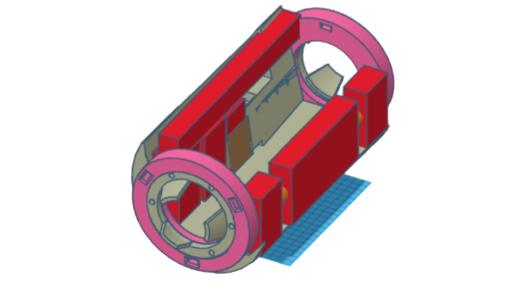
Receiving Food Supply - Manual Transport
Incoming spacecraft from Earth
Food production module

Slide 13
Food Storage

Slide 14
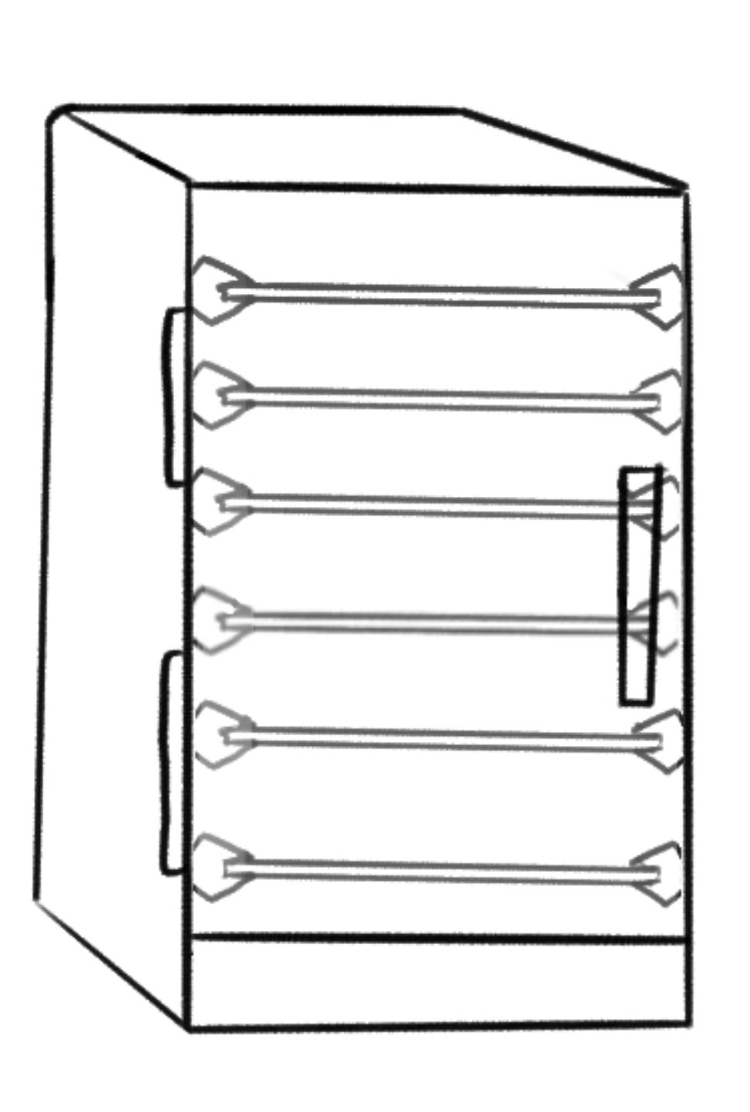
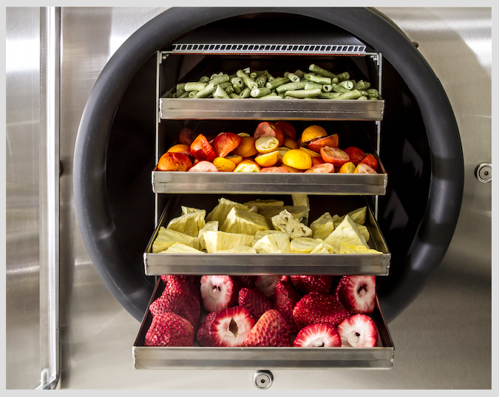
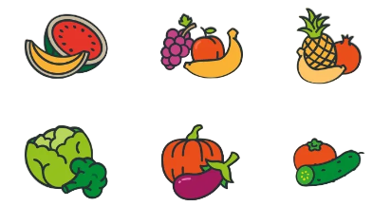
Freeze Dryer
Reduces 80-90% weight
Extends shelf-life for 25-30 years
Low power consumption
Retains original taste

Slide 15
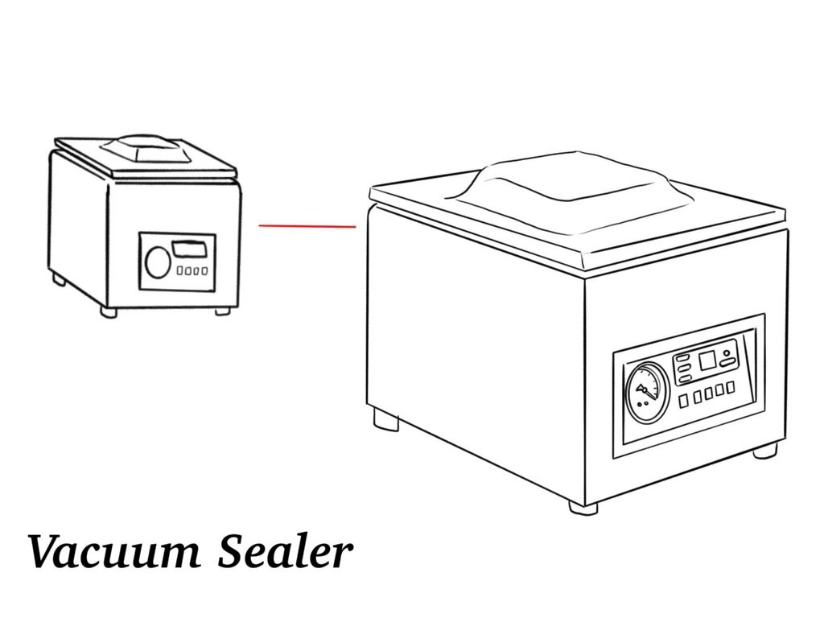
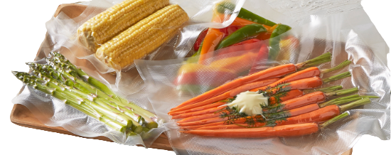
Vacuum Sealer
Prevents oxidation and moisture buildup

Slide 16
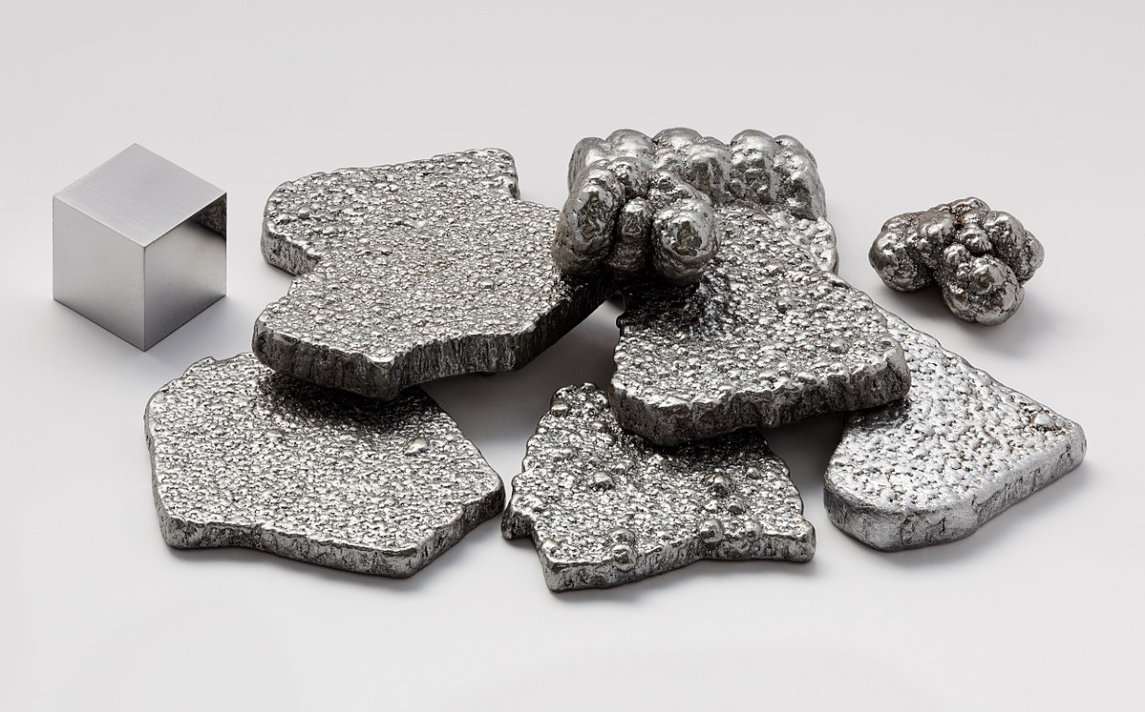
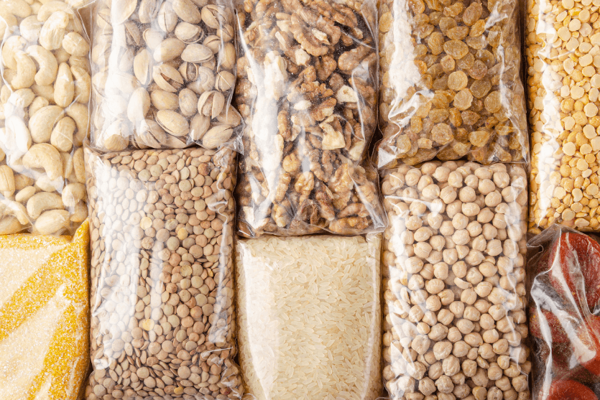

Storage Cabinets
Low material cost and durable
Organized in weightless environment

Slide 17
Storage Cabinets
1.1m³
Required storage space: 0.8m³
0.9m³

Slide 18
II. Food Preparation

Slide 19
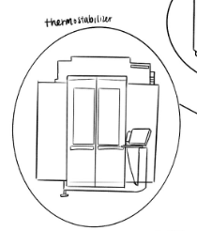
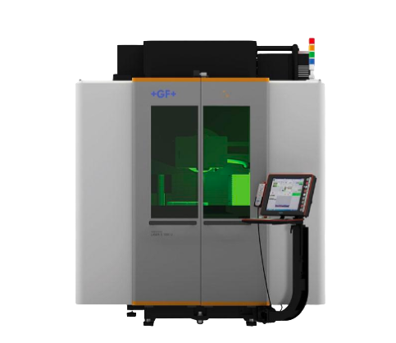
Thermostabilizer
Extends shelf-life of foods
Meats up to 3 yrs
Starches and vegetables up to 1 yr

Slide 20
Thermostabilizer
35%caloric density
5-10%moisture
22%decrease
🡩
🡫
=

Slide 21
Thermostabilizer
Palatable Food Taste
Low Energy Consumption

Slide 22
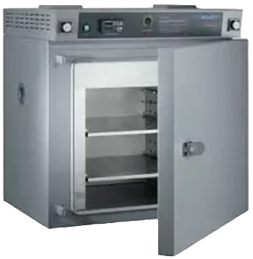
Microwave Oven
Lightweight
Low Cost
Low Energy Consumption

Slide 23
III. Water Treatment
& Storage

Slide 24
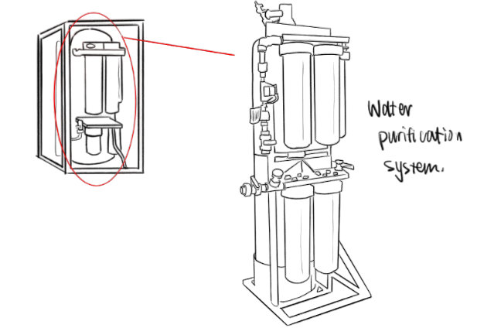
Water Purifier
Triple filtration process
Reuses wastewater from our freeze dryer and other modules

Slide 25
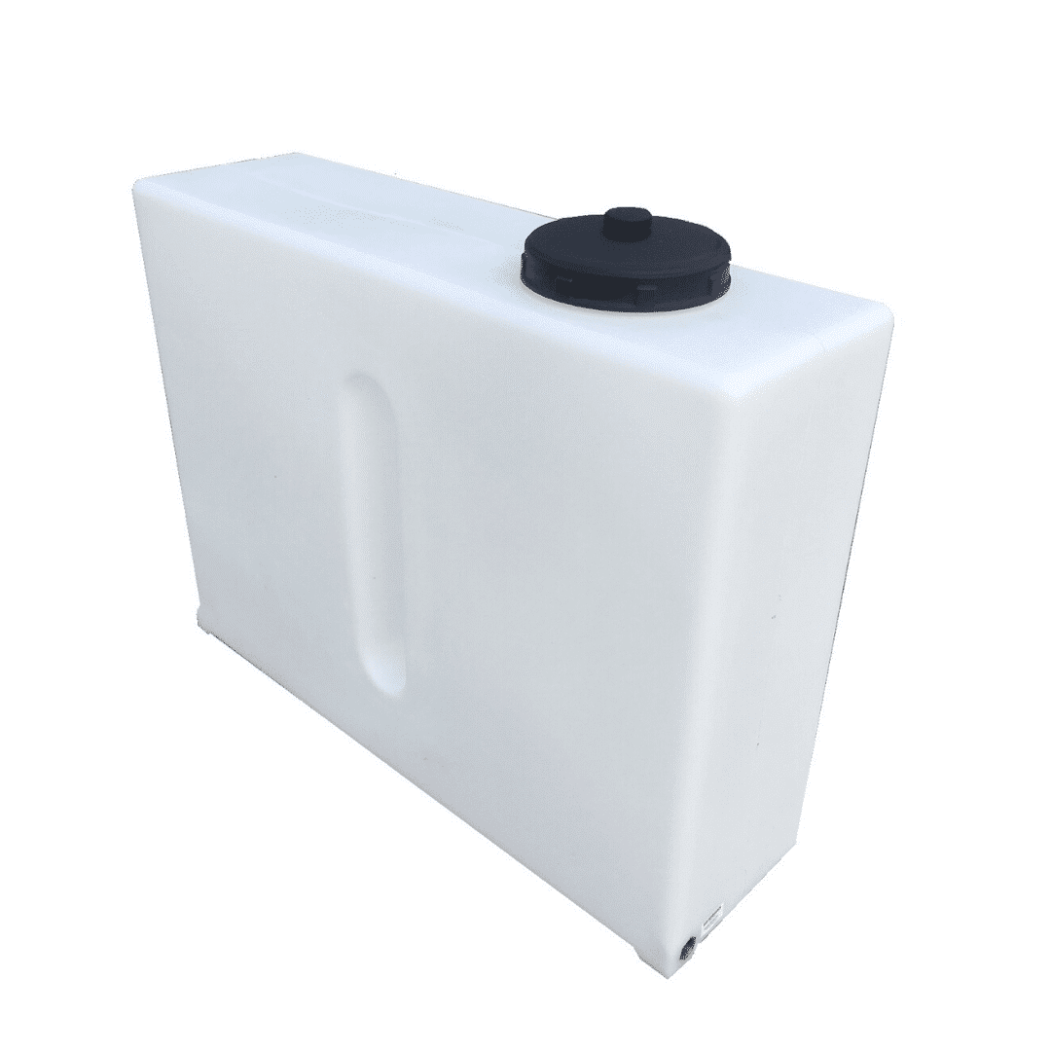
Water Storage
Lightweight and cheap
UV Sterilizer
Water pressure sensors
Stores 1.8m³ of water

Slide 26
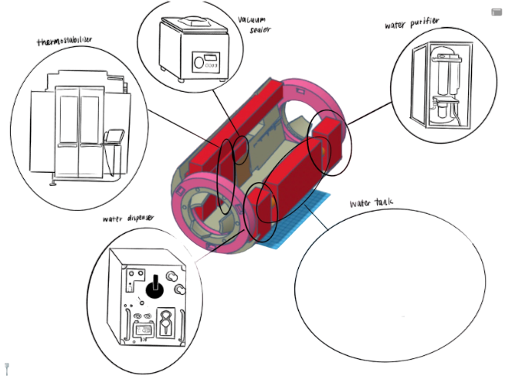
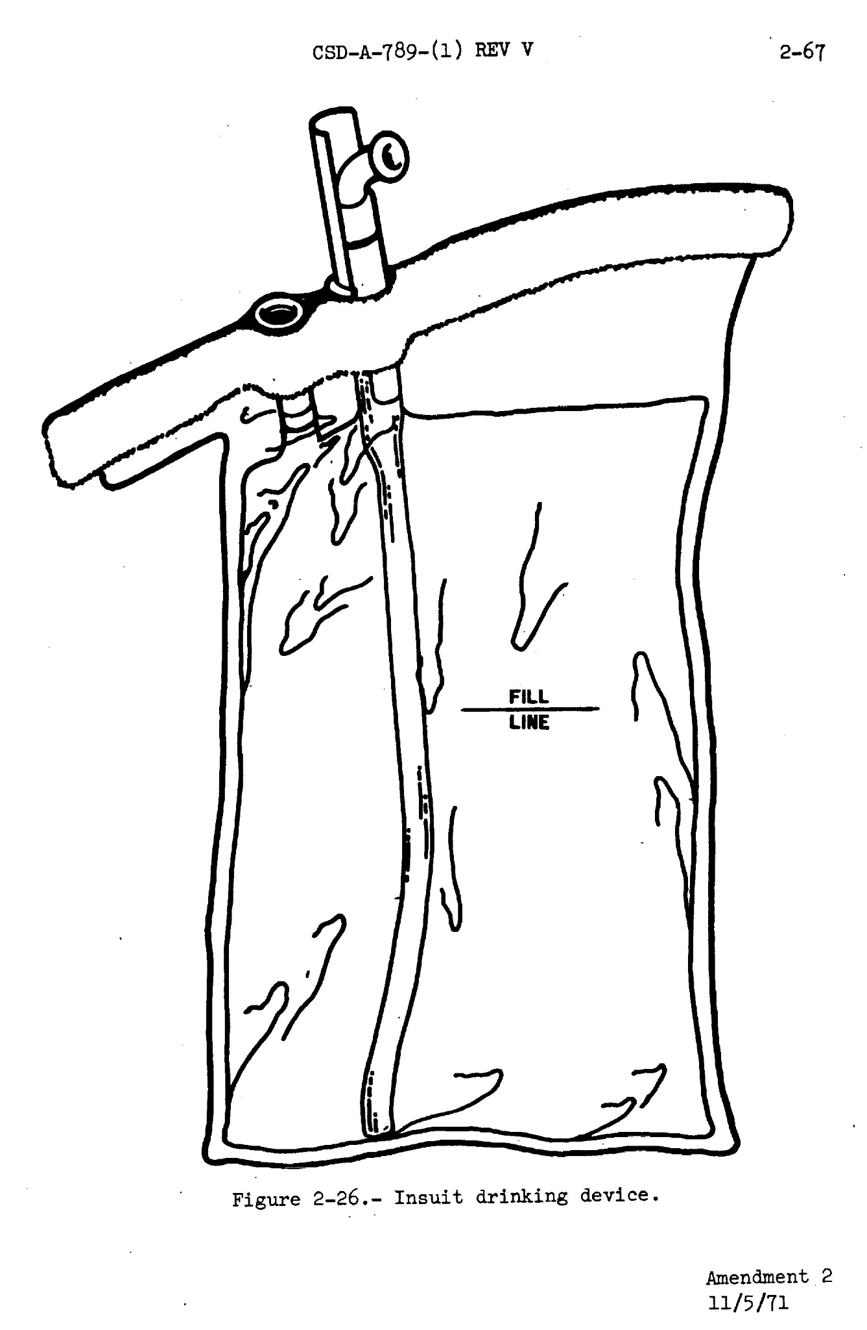
Water Dispenser
Drawn out through pressure differences

Slide 27

Total Energy Consumption:
Freeze dryer: 1.5 kW
Thermostablizer: 0.2 kW
Microwave: 1.2 kW
UV sterilizer: 0.05 kW
TOTAL: 2.95 kW

Slide 28
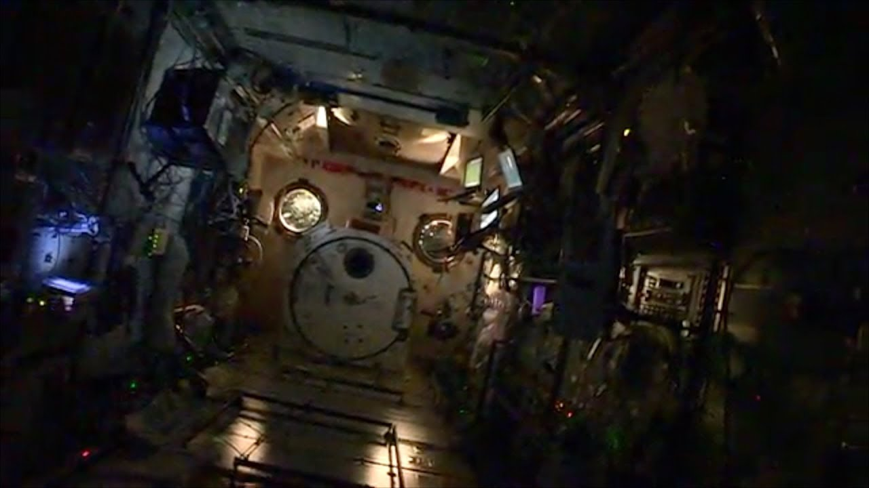

When the lunar gateway is uninhabited
None of our food needs refrigeration
No power is needed

Slide 29
Thank you!
Thank you!
Please keep this slide for attribution

